Slide 1
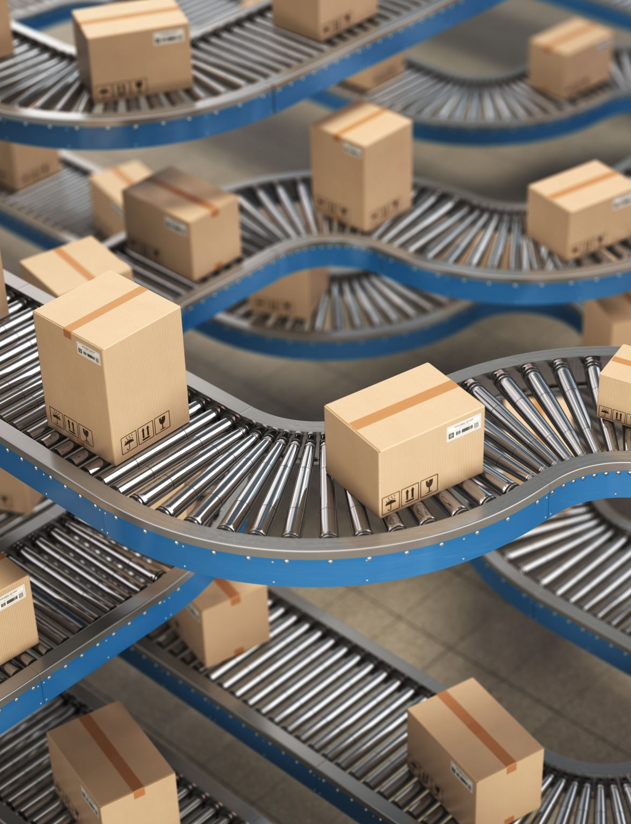
DATA pioneers inventory -A Comprehensive Oracle SQL-Based Solution
By:
Anand Pandey Kartik taneja

Slide 2

Project topic
An inventory management system using oracle SQL developer to efficiently track and manage stock, customers, and orders in a retail environment.

Slide 3

Problem Statement
Many small and mid-sized businesses face inventory management challenges:
Stock shortages leading to lost sales and dissatisfied customers
Overstocking increasing storage costs and obsolescence risk
Order processing delays affecting customer satisfaction
Manual tracking causing errors and inefficient management

Slide 4

ObjectiveS
Develop a structured inventory system using Oracle SQL
Implement well-defined database schema with clear relationships
Ensure accurate tracking of products, customers, and orders
Optimize query performance for efficient data retrieval
Maintain data integrity using constraints and relationships

Slide 5
Business Problem and Solutions
1. Stock Shortages Issue: Businesses often experience stockouts, leading to missed sales and dissatisfied customers. Solution: The system tracks product quantities in real-time and triggers low-stock alerts, ensuring timely restocking.
2. OverstockingIssue: Overstocking leads to excess inventory that ties up capital and incurs storage costs. Solution: The system maintains optimal stock levels by analyzing sales trends and generating reorder recommendations.
3. Manual Inventory TrackingIssue: Manual inventory management is prone to errors and inefficiencies.
Solution: The DataPioneers_Inventory system automates inventory tracking, reducing human errors and ensuring accuracy.
4. Difficulty in Tracking Customer Orders Issue: Managing and tracking customer orders manually is cumbersome and error-prone.
Solution: The system stores detailed customer orders, allowing for easy retrieval, tracking, and management of past and current orders.
5. Inefficient Order FulfillmentIssue: Delays in processing and shipping orders lead to customer dissatisfaction.
Solution: The database tracks the order status, product availability, and shipping process, enabling faster and more efficient order fulfillment.
6. Lack of Integration Between Sales and InventoryIssue: Disconnected systems for sales and inventory can lead to inaccurate stock levels.
Solution: The system integrates sales and inventory, ensuring real-time updates to stock levels whenever a sale occurs.
7. Inaccurate Product Information Issue: Incorrect or outdated product data can lead to poor customer experience and operational inefficiencies.
Solution: The solution centralizes product information, making it easy to update product details such as prices, descriptions, and stock levels

Slide 6
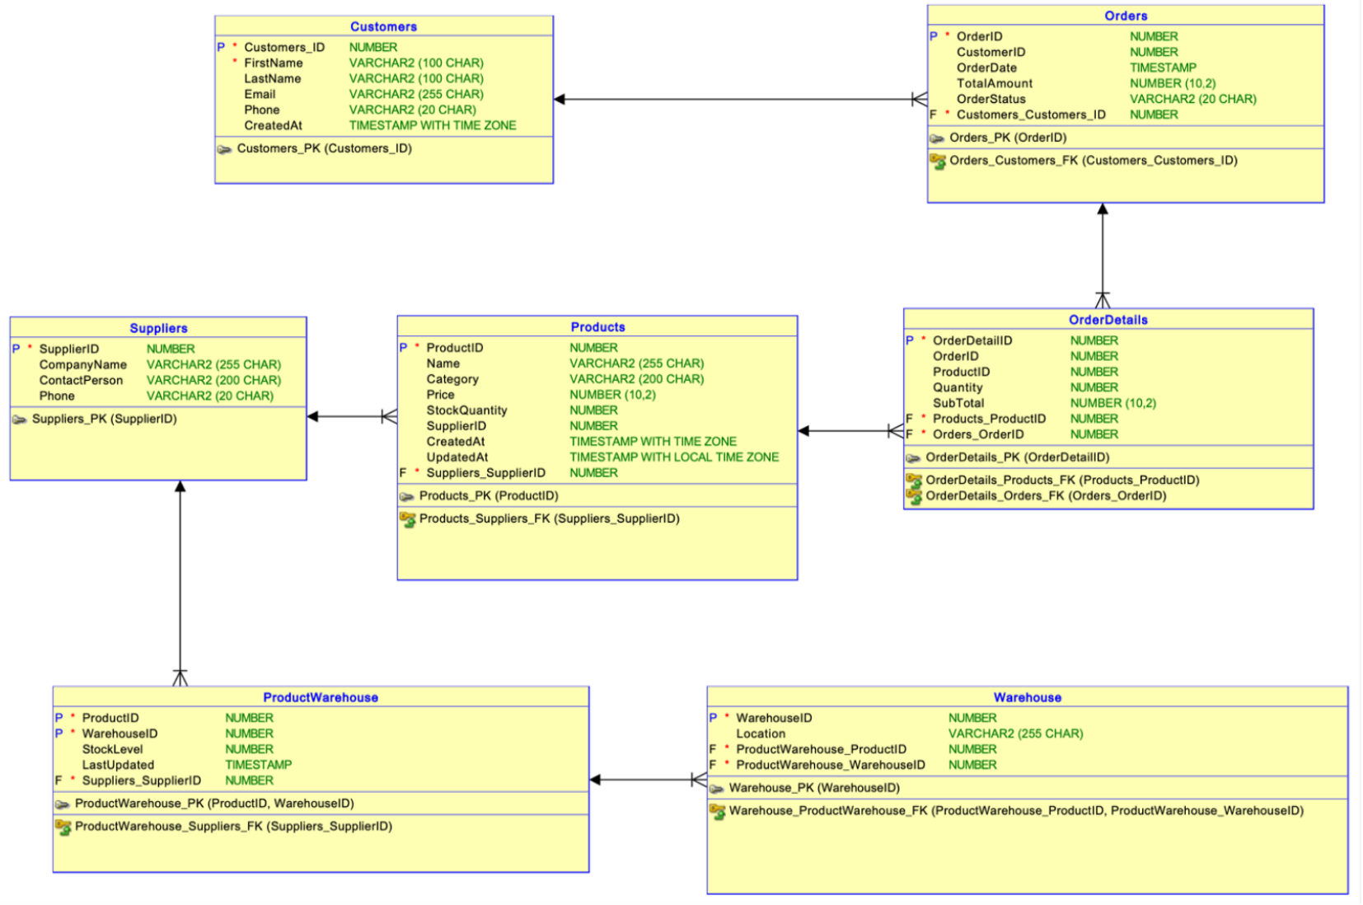
ER Diagram

Slide 7
Business Problem and Solutions
1. Poor Data IntegrityIssue: Manual data entry and a lack of structure can compromise data accuracy and integrity.Solution: By using constraints (like primary keys and foreign keys) and enforcing data relationships, the system ensures that data is accurate and consistent.
2.

Slide 8
Business Problem and Solutions
.8. Problem: Poor Data IntegrityIssue: Manual data entry and a lack of structure can compromise data accuracy and integrity.Solution: By using constraints (like primary keys and foreign keys) and enforcing data relationships, the system ensures that data is accurate and consistent.9. Problem: Difficulty in Reporting and Data AnalysisIssue: Without structured data, businesses struggle to generate meaningful reports and analyze performance.Solution: The system provides a relational database design, making it easy to generate detailed reports on sales, inventory levels, and customer orders.10. Problem: Difficulty in Managing Multiple WarehousesIssue: Managing stock across multiple locations can become complicated and disorganized.Solution: The system can track inventory across various warehouses, providing a centralized view of stock levels and facilitating better inventory management.11. Problem: Lack of Visibility into Product MovementIssue: Companies struggle to track the movement of products from suppliers to customers.Solution: The system logs and tracks each product's journey, from the point of sale to delivery, giving businesses full visibility into their supply chain.12. Problem: Unreliable Supplier RelationshipsIssue: Poor supplier management can lead to delays and missed deliveries.Solution: The system can store supplier information and track performance, enabling businesses to make informed decisions about restocking and supplier reliability.13. Problem: Inconsistent PricingIssue: Having inconsistent pricing strategies can confuse customers and reduce sales.Solution: The system tracks prices for each product and allows easy updates across multiple product categories, ensuring pricing consistency.14. Problem: Lack of Customer Relationship ManagementIssue: Businesses often don’t have a clear record of customer interactions, leading to poor customer service.Solution: The system stores detailed customer profiles, allowing businesses to engage with customers more effectively and provide personalized service.15. Problem: Difficulty in Forecasting DemandIssue: Poor demand forecasting can lead to stockouts or excess inventory.Solution: The system analyzes historical sales data, helping businesses predict demand more accurately and optimize stock levels

Slide 9

DATAbase design
Business problem and how it is addressed with this solution

Slide 10
SELECTING VISUAL AIDS
ENHANCING YOUR PRESENTATION

Slide 11
EFFECTIVE DELIVERY TECHNIQUES
Effective body language enhances your message, making it more impactful and memorable.
Meaningful eye contact
Purposeful gestures
Maintain good posture
Control your expressions
This is a powerful tool in public speaking. It involves varying pitch, tone, and volume to convey emotion, emphasize points, and maintain interest.
Pitch variation
Tone inflection
Volume control

Slide 12
NAVIGATING Q&A SESSIONS
Know your material in advance
Anticipate common questions
Rehearse your responses
Maintaining composure during the Q&A session is essential for projecting confidence and authority. Consider the following tips for staying composed:
Stay calm
Actively listen
Pause and reflect
Maintain eye contact

Slide 13

SPEAKING IMPACT
Your ability to communicate effectively will leave a lasting impact on your audience
Effectively communicating involves not only delivering a message but also resonating with the experiences, values, and emotions of those listening

Slide 14
DYNAMIC DELIVERY
Learn to infuse energy into your delivery to leave a lasting impression
One of the goals of effective communication is to motivate your audience
Metric | Measurement | Target | Actual
Audience attendance | # of attendees | 150 | 120
Engagement duration | Minutes | 60 | 75
Q&A interaction | # of questions | 10 | 15
Positive feedback | Percentage (%) | 90 | 95
Rate of information retention | Percentage (%) | 80 | 85

Slide 15
FINAL TIPS & TAKEAWAYS
Consistent rehearsal
Strengthen your familiarity
Refine delivery style
Pacing, tone, and emphasis
Timing and transitions
Aim for seamless, professional delivery
Practice audience
Enlist colleagues to listen & provide feedback
Seek feedback
Reflect on performance
Explore new techniques
Set personal goals
Iterate and adapt

Slide 16

THANK YOU

